Slide 2
Building a Single Page Application with ASP.NET and Angular.js
David CATUHE
Senior Program Manager
@deltakosh
Jon GALLOWAY
Senior SDE
@jongalloway

Slide 3


April 4, 2014 from 10:30AM to 11:30AM
Day 3
Room 2018
3-558

Slide 4

Agenda
First contact with Angular.js
Getting data
Routing and views
ASP.NET Web API
Real-time synchronization
Debug & Deployment

Slide 5
First contact with Angular.js
MVC framework
For Single Page Application You need only one script file:
<script src="angular.min.js"></script>
Latest version here:
http://code.angularjs.org/
Notes:
Step 1 here

Slide 6
Demo

Slide 7
Adding angular.js to MVC
Simple: CDN script references
Bonus points: NuGet
Notes:
Step 1A here
Options listed in code:
Download files and reference them
NuGet
CDN

Slide 8
Angular + ASP.NET Approaches
Static HTML
ASP.NET MVC (mini-SPA)

Slide 9
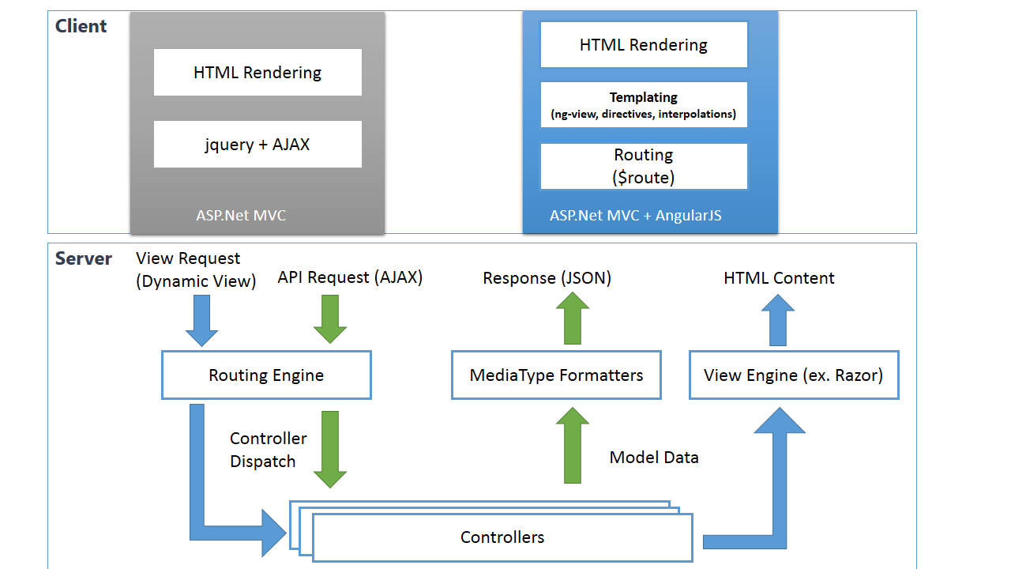
Source: http://blog.technovert.com/2013/12/setting-up-angularjs-for-asp-net-mvc-n-webapi-project/

Slide 10
Angular + ASP.NET Script Reference
Bundling
Minification (watch out!)

Slide 11
Demo

Slide 12
First contact with Angular.js
angular.js
Module
Controllers
Dependencies Injection
Notes:
Angular.js is an MVC framework – strong separation between data and view through a controller
It uses dependencies injection to resolve dependencies
Step 2

Slide 13
Demo

Slide 14
Getting data
angular.js
angular-resource.js
$http
$resources
Filters
Notes:
Step 3
Step 4
Step 5

Slide 15
Demo

Slide 16
ASP.NET MVC and Web API



HTML
JSON
XML
Web Forms
Web Pages
MVC
Web API
ASP.NET Core
Notes:
So far, we’ve been using MVC to deliver HTML
Now we’ll be using Web API for HTTP services (data)

Slide 17
Demo
Notes:
5A

Slide 18
Routing and views
angular.js
angular-resource.js
angular-animate.js
angular-route.js
SPA uses views to build UI
Angular.js uses routing to define views
Animations
Notes:
Demo:
Moving current content to list.html
Adding a ng-view tag
Adding routing to app.js (angular-route)
New view detail.html
Step 6

Slide 19
Demo
Notes:
6

Slide 20
Angular + ASP.NET Routing
Deep links in Angular can conflict with MVC Routes
Use a Catchall route
routes.MapRoute( name: "Catch all route for SPA", url: "App/{*catchall}", defaults: new{ controller = "Home", action = "Index"});

Slide 21
ASP.NET + Angular Routing
HTML from view – no problem!
HTML file – use an IIS Rewrite rule
/cards.html -> /cards
Notes:
Demo:
Update site to use Web API
Step 6A

Slide 22
Demo
Notes:
Step 6A

Slide 23
Real-time synchronization
angular.js
angular-resource.js
angular-animate.js
angular-route.js
Using localStorage
Difference between getting data and synchronization
SignalR
Notes:
Demo:
Add dual-binding in detail
Ng-change to update locally
Reload changes at start
Using signalR to do a real time sync

Slide 24
Demo
Notes:
Step 6
Local storage

Slide 25
Without real-time
Got Data?
Got Data?
Got Data?
Got Data?
Client Browser
Web Server
Here’s some data!
Got Data?
Got Data?
Got Data?
Got Data?
Notes:
This demonstrates the way SignalR works over an HTTP connection using long polling or one of the other pre-Web Socket or pre-Server Sent Events methods.
The web server makes an outbound request to the web server. CLICK
If the web server is ready to return something, it does so. CLICK
Once the server responds, the client begins making the requests again until the server responds. CLICK

Slide 26
With real-time
I do real time, do you?
Client Browser
Web Server
Absolutely!
Let’s Do This!

Slide 27
Basically…
Client Browser
SignalR!!!
Web Server

Slide 28
Benefits of SignalR
Abstraction over transports
Events instead of task/async
Connection management
Broadcast or target specific client

Slide 29
Demo

Slide 30
Debug and deployment
Jasmine
Azure Web Deployment

Slide 31

© 2014 Microsoft Corporation. All rights reserved. Microsoft, Windows, Windows Vista and other product names are or may be registered trademarks and/or trademarks in the U.S. and/or other countries.
The information herein is for informational purposes only and represents the current view of Microsoft Corporation as of the date of this presentation. Because Microsoft must respond to changing market conditions, it should not be interpreted to be a commitment on the part of Microsoft, and Microsoft cannot guarantee the accuracy of any information provided after the date of this presentation. MICROSOFT MAKES NO WARRANTIES, EXPRESS, IMPLIED OR STATUTORY, AS TO THE INFORMATION IN THIS PRESENTATION.

